Slide 1


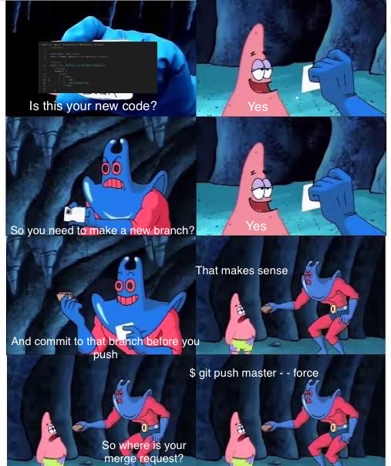
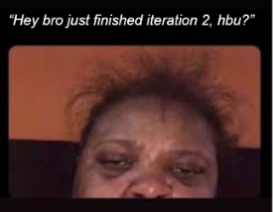
COMP1531 | T09B / H17B Week 8
william.huynh3@unsw.edu.au

Slide 2
Learning objectives
Iteration 3: It’s not that bad
Coverage: Making our tests cover all our code
State Diagrams: Understanding how we design software stages

Slide 3
Iteration 3 Tasks
48 Functions (29 are old, 19 are new)
Major Tasks (55%)
Minor Tasks (45% + 10% Bonus)
Hash your tokens & passwords
Code quality (10%)
Send tokens in the header instead of body
Feature Demos (10%)
deployment
uploadPhoto & passwordReset
packend powers the frontend
Throw HTTP Errors instead of returning an error object
Write new HTTP Tests
Git & Project Management (10%)
Implement new functions
Requirements Documentation (15%)
Fully TypeScripted Code (+10% bonus)

Slide 4
Iteration 2 Tasks
29 Functions (11 are old, 18 are new)
Major Tasks (50%)
Minor Tasks (50%)
TypeScript your project
Code quality (30%)
Setup Continuous Integration (pipeline)
Git Practices (20%)
Write new HTTP Tests
Implement new functions
Write the API (server.ts)
Setup persistence
Power the frontend
Linting your code

Slide 5
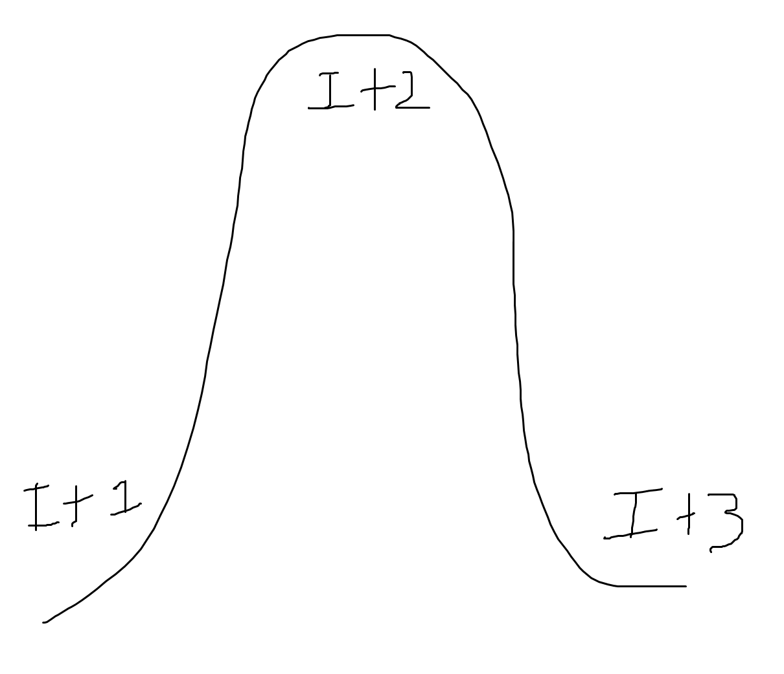

Slide 6
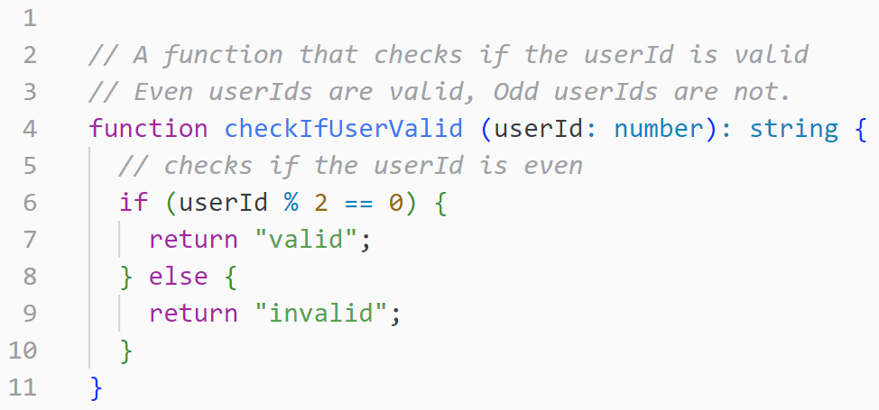
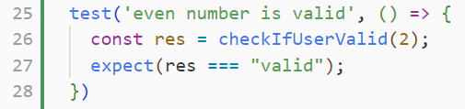

Slide 7
Coverage: Making sure all our code is tested
Code coverage is a metric to quantify how much of written
code has been executed during testing.
For HTTP programs
(Iteration 3)
For regular JS programs
(Labs / Tute Activity)
npm run ts-node-coverage
npm run jest --coverage
Coverage contributes towards 10% of Iteration 3 (Code Quality criteria)

Slide 8
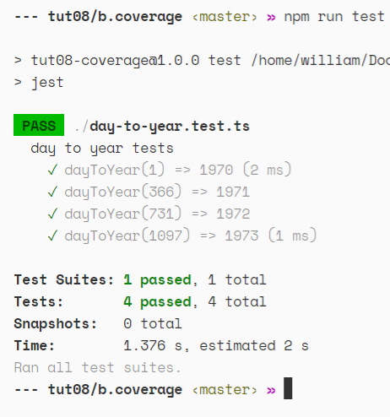
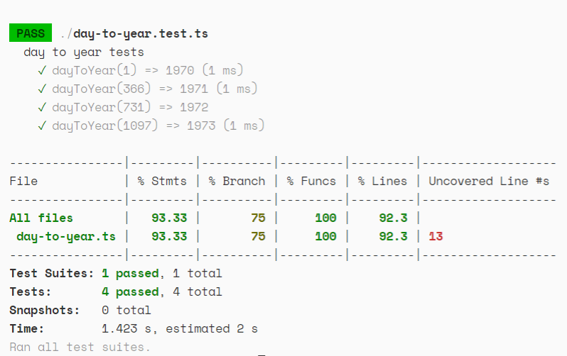
Coverage: The differences?
Not only will JEST tell you what tests you passed/failed but it will also tell you how many lines of code are not being run in your tests!

Slide 9


Coverage: The Metrics of Coverage
Statements
Branch
Functions

Slide 10
Statement Coverage
Statement coverage checks that all lines of code are executed at least once

Slide 11
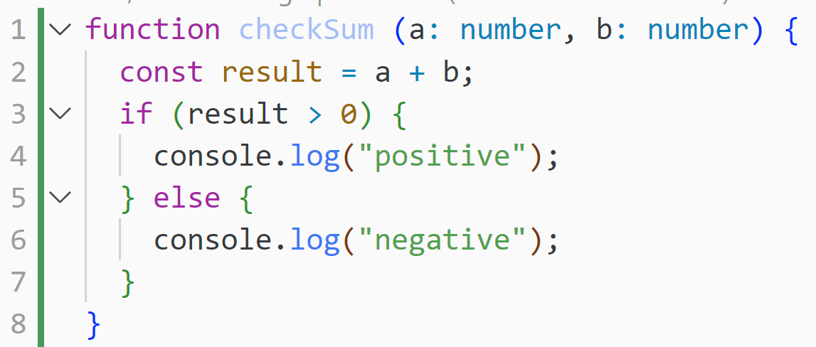
There are 6 total statements

Slide 12
a = 5, b = 10
Line 1, 2, 3 and 4 are the executed statements

Slide 13
a = -1, b = -2
What are the executed statements?

Slide 14
Branch Coverage
Branch coverage checks how many of the branches of the control structures (for example if statements) have been executed.

Slide 15
Function Coverage
Function coverage checks how many functions have been called in your test files
Number of called functions
Function coverage =
Total number of functions

Slide 16
Function Coverage
Function coverage checks how many functions have been called in your test files
Number of called functions
Function coverage =
Total number of functions

Slide 17
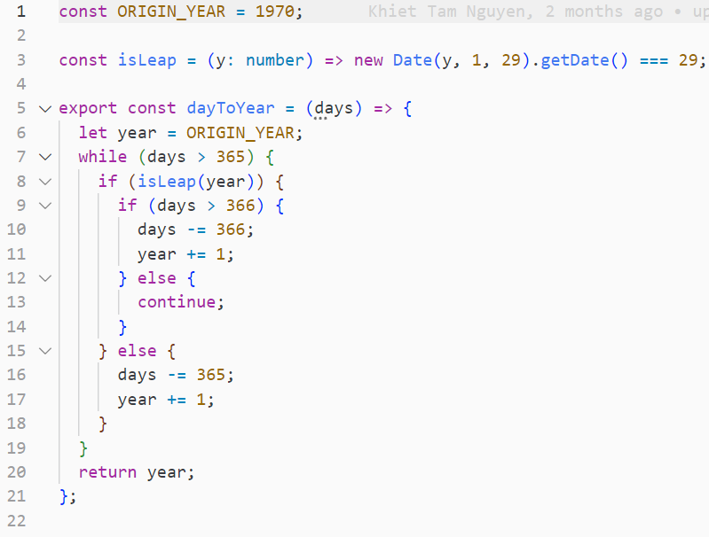
Activity
You have been provided a function in b.coverage/day-to-year.ts
In your project groups:
Figure out what the function does
Run the regular JEST tests and observe the results
Add coverage to JEST
Rerun the tests and observe the coverage report
Write tests to achieve 100% coverage!
Time Limit: 20 minutes

Slide 18
State Diagrams: Understanding how programs responds to actions
A State Diagram is a diagrammatic representation of a state.
There are two symbols in a state diagram: Circles & Arrows
Circles represent states.
Arrows represents transitions
State Diagrams contribute to 15% of Iteration 3 (Requirements Documentation)

Slide 19
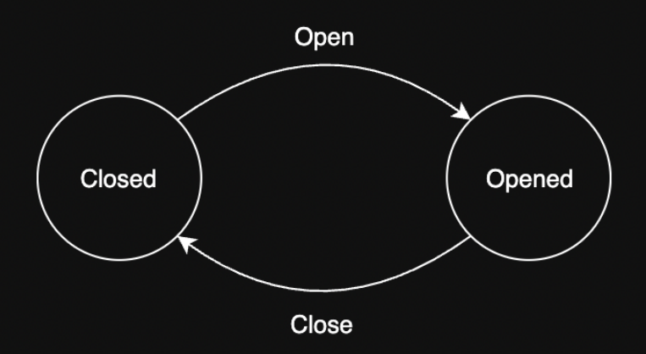
State Diagrams: A state diagram for a door

Slide 20
State Diagrams: An (incomplete) state diagram for AUTH
User is at login page
Types in credentials
User clicks login
Password is incorrect
User is at home page
User is prompted to login again
Types in credentials
User is at register page
User clicks register
Credentials are invalid
User is prompted to register again

Slide 21
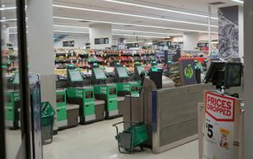
Activity
In your project groups, create a state diagram of a major feature in project-backend. This could be:
Auth (recommended)
Channel
Channels
DM
Users
Time Limit: 20 minutes

